Slide 1

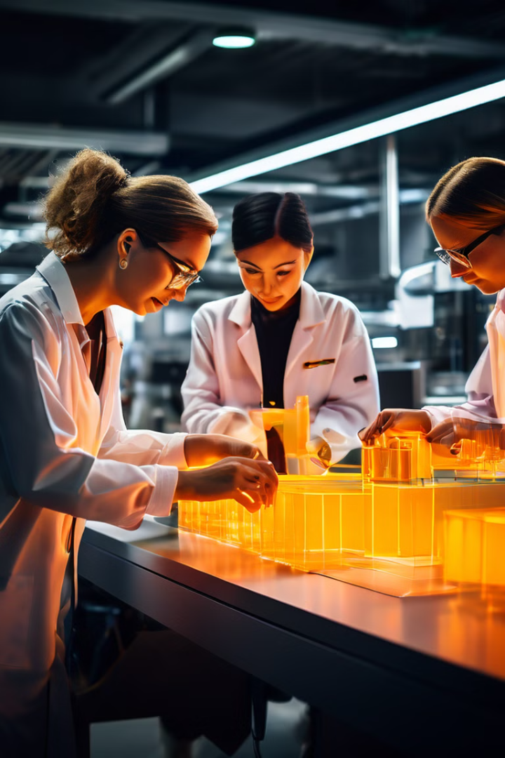


Leveraging Innovation for Inclusive and Sustainable Industrialization
This presentation explores the potential of my project to address the 9th Sustainable Development Goal (SDG), which aims to promote inclusive and sustainable industrialization and foster innovation.
by Ian Musyoki

Slide 2

Overview of SDG 9: Industry, Innovation, and Infrastructure
The 9th SDG focuses on building resilient infrastructure, promoting inclusive and sustainable industrialization, and fostering innovation.
Infrastructure for All
Sustainable Industrialization
Innovation and Technology
Ensuring access to affordable, reliable, sustainable, and modern energy for all.
Promoting sustainable industrialization, including by increasing resource efficiency and promoting clean technologies.
Encouraging innovation and supporting the development and diffusion of environmentally sound technologies.

Slide 3
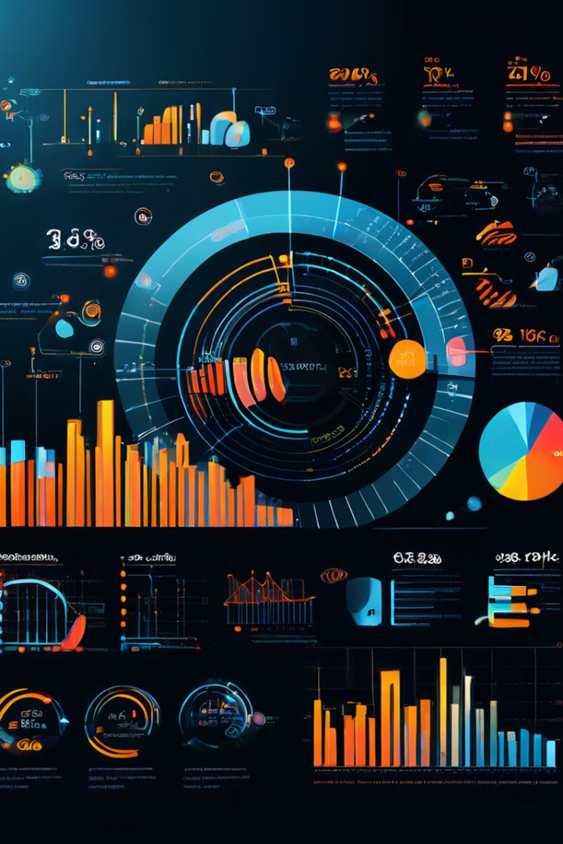
Data Sources and Methodology
Data for this project is drawn from a variety of sources, including industry reports, government statistics, and surveys.
Data Source
Type
Description
World Bank
Government Statistics
Economic indicators related to industry and infrastructure development.
UNIDO
Industry Reports
Global trends in industrialization, innovation, and sustainability.
Global Footprint Network
Environmental Impact Data
Metrics on resource consumption and ecological footprint associated with industrial activities.

Slide 4
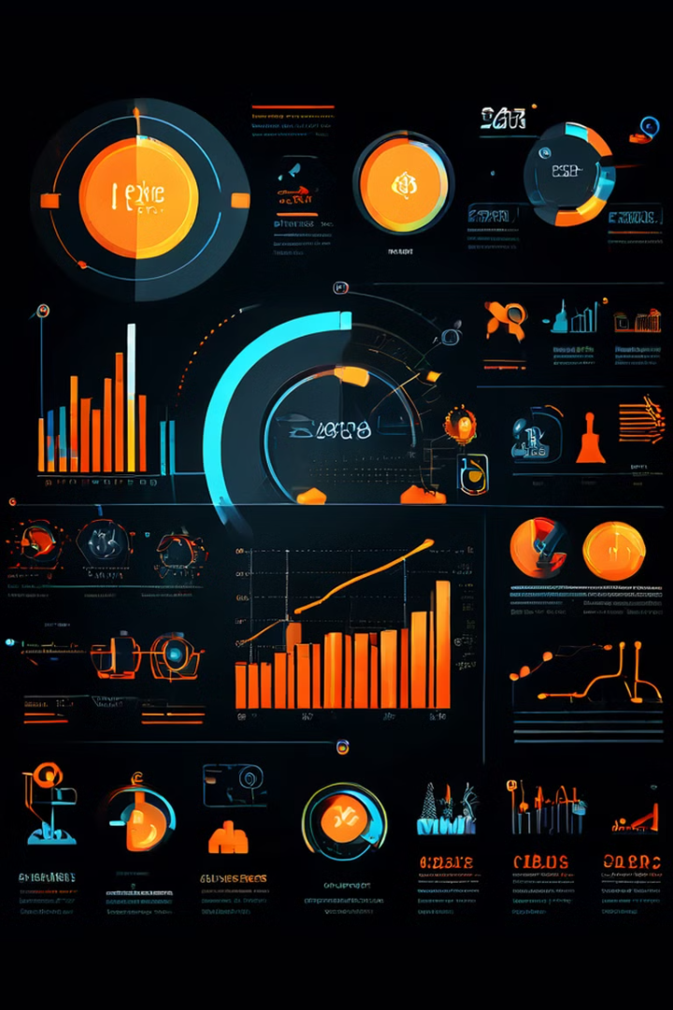
Key Performance Indicators (KPIs)
To measure the impact of the project on SDG 9, several key performance indicators (KPIs) are used.
1
Job Creation
2
Resource Efficiency
Number of new jobs created in the target industry.
Reduction in resource consumption per unit of production.
3
Innovation Adoption
4
Environmental Impact
Number of companies adopting sustainable technologies.
Reduction in greenhouse gas emissions and pollution.

Slide 5
Visualizing the Data: Dashboard Design
A data visualization dashboard provides a comprehensive overview of the project's progress toward SDG 9 objectives.
KPIs Overview
Geographic Distribution
Trend Analysis
Displays key performance indicators (KPIs) in real-time.
Visualizes the project's impact across different regions.
Provides insights into the long-term performance and trends.

Slide 6




Insights and Findings
Analysis of the data reveals encouraging trends in several areas.
Increased Resource Efficiency
Significant improvements in resource utilization and waste reduction.
Innovation Adoption
Growing adoption of sustainable technologies among industry players.
Job Creation
Positive impact on employment opportunities in the target industry.

Slide 7





Challenges and Limitations
Despite progress, the project faces challenges and limitations.
Funding Constraints
Policy Barriers
Limited financial resources for scaling up project activities.
Lack of supportive policies and regulations for sustainable industrialization.
Technological Gaps
Collaboration Gaps
Challenges in accessing and adopting advanced technologies.
Need for stronger collaboration among stakeholders.

Slide 8

Conclusion and Next Steps
This project demonstrates the potential of innovation and collaboration to advance SDG 9.
1
Strengthen Partnerships
Expand collaboration with governments, industry, and NGOs.
2
Scale Up Project Activities
Increase the reach and impact of the project.
3
Advocate for Policy Changes
Promote policies that support sustainable industrialization.
4
Continue Monitoring and Evaluation
Track progress and make necessary adjustments.

